Slide 1
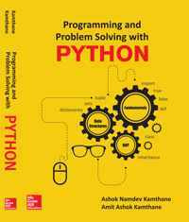
Programming and problem solving with python
Chapter 4
Decision Statements
Copyright © 2018 McGraw Hill Education, All Rights Reserved.
PROPRIETARY MATERIAL © 2018 The McGraw Hill Education, Inc. All rights reserved. No part of this PowerPoint slide may be displayed, reproduced or distributed in any form or by any means, without the prior written permission of the publisher, or used beyond the limited distribution to teachers and educators permitted by McGraw Hill for their individual course preparation. If you are a student using this PowerPoint slide, you are using it without permission.

Slide 2
Decision Statements
The list of decision statements supported by python is as follows:
The if Statements
The if-else Statements
Nested if statements
Multi-way if-elif-else Statements

Slide 3
The if Statement
The if statement executes the statements following the if statement if the condition is true.
Syntax of if Statement is as follows
Details of if Statement
The keyword if begins the if statement
The condition is a Boolean expression that determines whether or not the body of if block will be executed.
A colon(:) must always be followed by the condition.
The block may contain one or more statements. The statement or statements are executed if and only if the condition within the if statement is true.
if condition: statement(s)

Slide 4
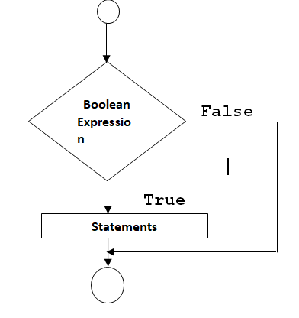
Flow Chart of if statement

Slide 5
Example of if Statement
Write a Program to print You are eligible to vote if age is greater than or equal to 100.
Solution:
age = int(input('Enter the age:')) print(' Entered Age is:', age) if age >= 18: print('You are eligible to Vote') Output: Enter the age:34 Entered Age is: 34 You are eligible to Vote

Slide 6
The if-else Statement
The if-else statements take care of true and false conditions. It has two blocks i.e. One block is for if and other block is of else.
Syntax of if – else block is as follows
The if block may contain one or more than one statements.
Block following to if is executed( when the condition is true) and else block is executed when the condition is false.
if condition: if_Block else: else_Block

Slide 7
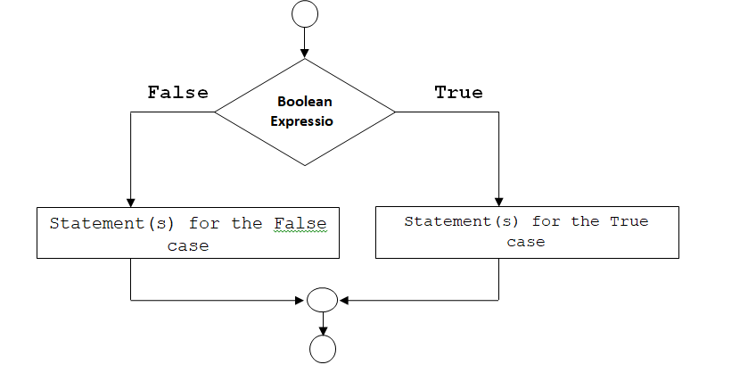
Flow Chart of if-else statement

Slide 8
Program on if - else statement
Write a program to display message You can Vote if age is greater than 18 or display message You are not eligible for voting.
age = int(input('Enter the age:')) print(' Entered Age is:',age) if age >= 18: print('You can Vote ') else: print('You are not eligible for voting') Output: Enter the age:12 Entered Age is: 12 You are not eligible for voting

Slide 9
Nested if statements
The if statement inside another if statement then it is called nested if statements.
Syntax of nested if statement is as follows
if Boolean-expression1: if Boolean-expression2: statement1 else : statement2 else : statement3

Slide 10
The if-elif-else statement
Syntax of if-elif-else is as follows
In this kind of statements, number of conditions i.e. boolean expressions are checked from top to bottom.
When the true condition is found, the statement associated with it is executed and the rest of conditional statements are skipped.
If none of the conditions are true, then the last else statement is executed.
If all other conditions are false and if the final else is not present then no action place
if Boolean-expression1: statement1 elif Boolean-expression2 : statement2 elif Boolean-expression3 : statement3 - - - - - - - - - - - - - - - - - - - - - - - -- - elif Boolean-expression n : statement N else: Statement(s)

Slide 11
Program on if-elif-else statement
Write a program to prompt the user to enter the day of week. If the entered day of week is between 1 and 7 then display respective name of the day.
Solution:
Day=int(input(“Enter the day of week:”)) if day==1: print(" Its Monday") elif day==2: print("Its Tuesday") elif day==3: print("Its Wednesday") elif day==4: print("Its Thursday") elif day==5: print("Its Friday") elif day==6: print("Its Saturday") elif day==7: print(" Its Sunday") else: print("Sorry!!! Week contains only 7 days") Output: Enter the day of week:7 Its Sunday

Slide 12
Conditional Expressions
The general form of conditional expression is as follows:
Expression₁ if condition else Expression₂
Example
Consider the following piece of code
if x%2==0:
x = x + 1
else:
x = x + 2
To improve the performance of simple if-else statement, python has provides above concept named conditional expression. Thus above solution by using conditional expression is as follows
x*x if x % 2 == 0 else x*x*x

Slide 13
Conclusion
Python Supports various decision statements such as if, if-else, and Multi-way if-elif-else statements.
Python does not have a ternary operators. But instead it has a Conditional Expression.

